Slide 1
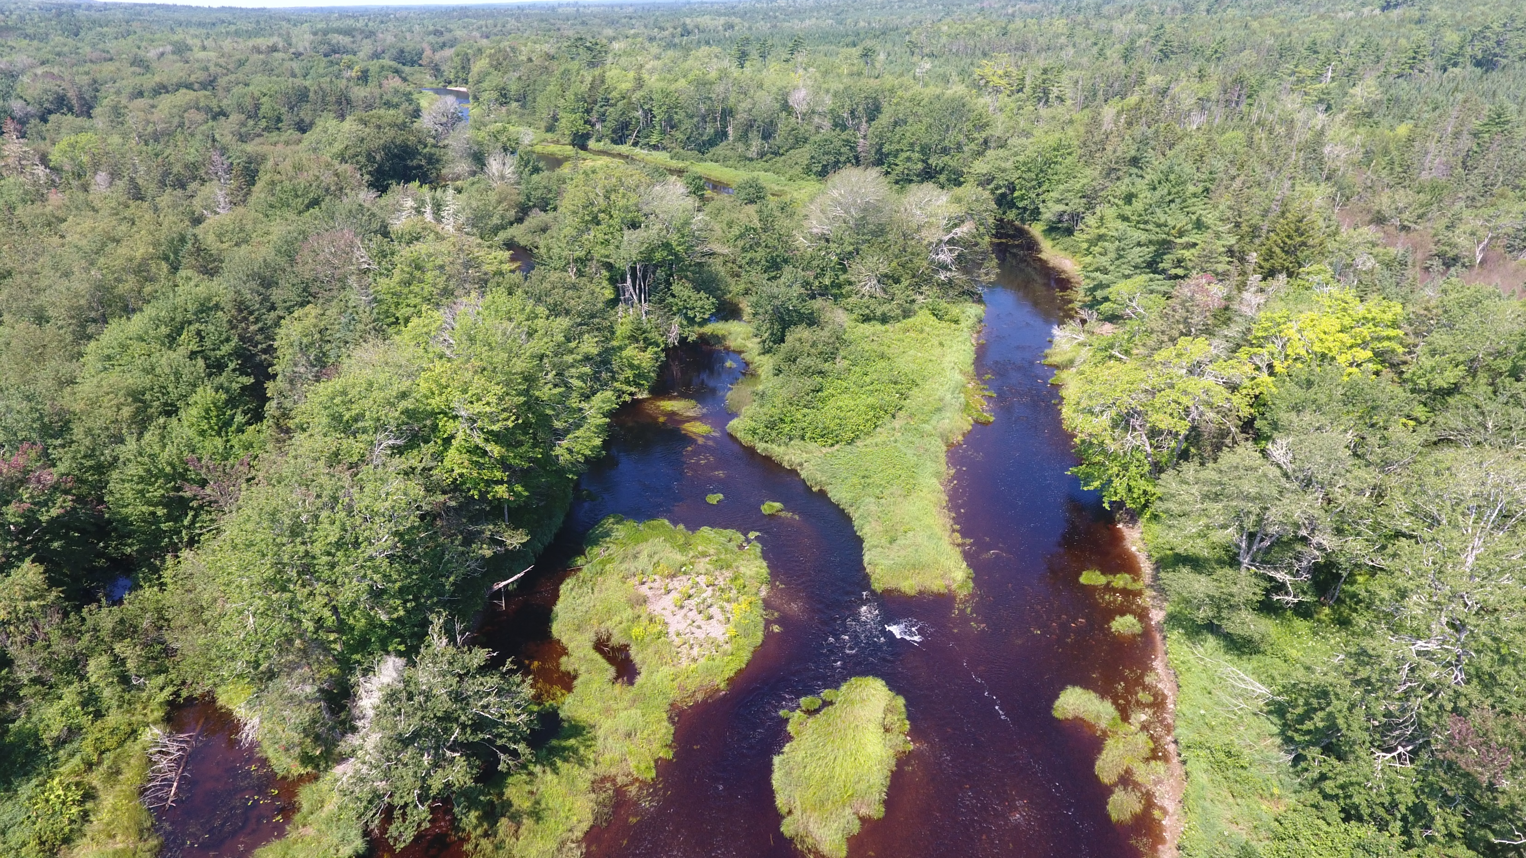
Habitat Restoration and Atlantic Salmon Conservation
St. Mary’s River Watershed

Slide 2
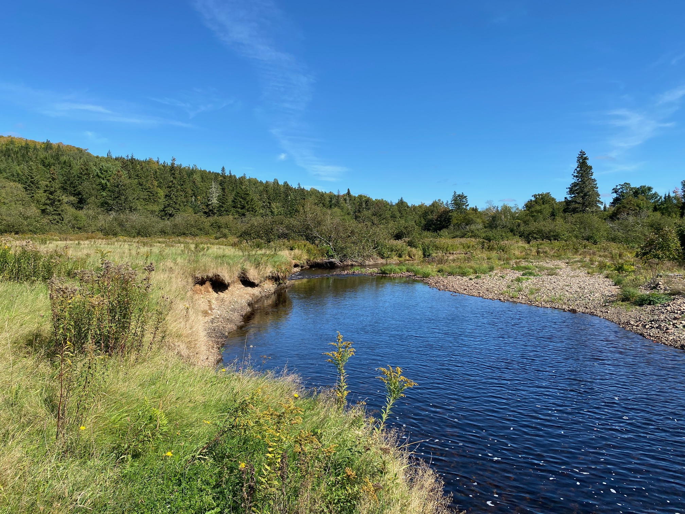
2022 Restoration Work
Work was conducted on four restoration sites on the East River St. Mary’s.
Black Brook: Bank stabilization and riparian zone restoration
MacKay’s Brook: Digger log installation project
East River, Willowdale Site: Bank stabilization and riparian zone restoration.
East River, Newtown: East River Road bank stabilization project.

Slide 3
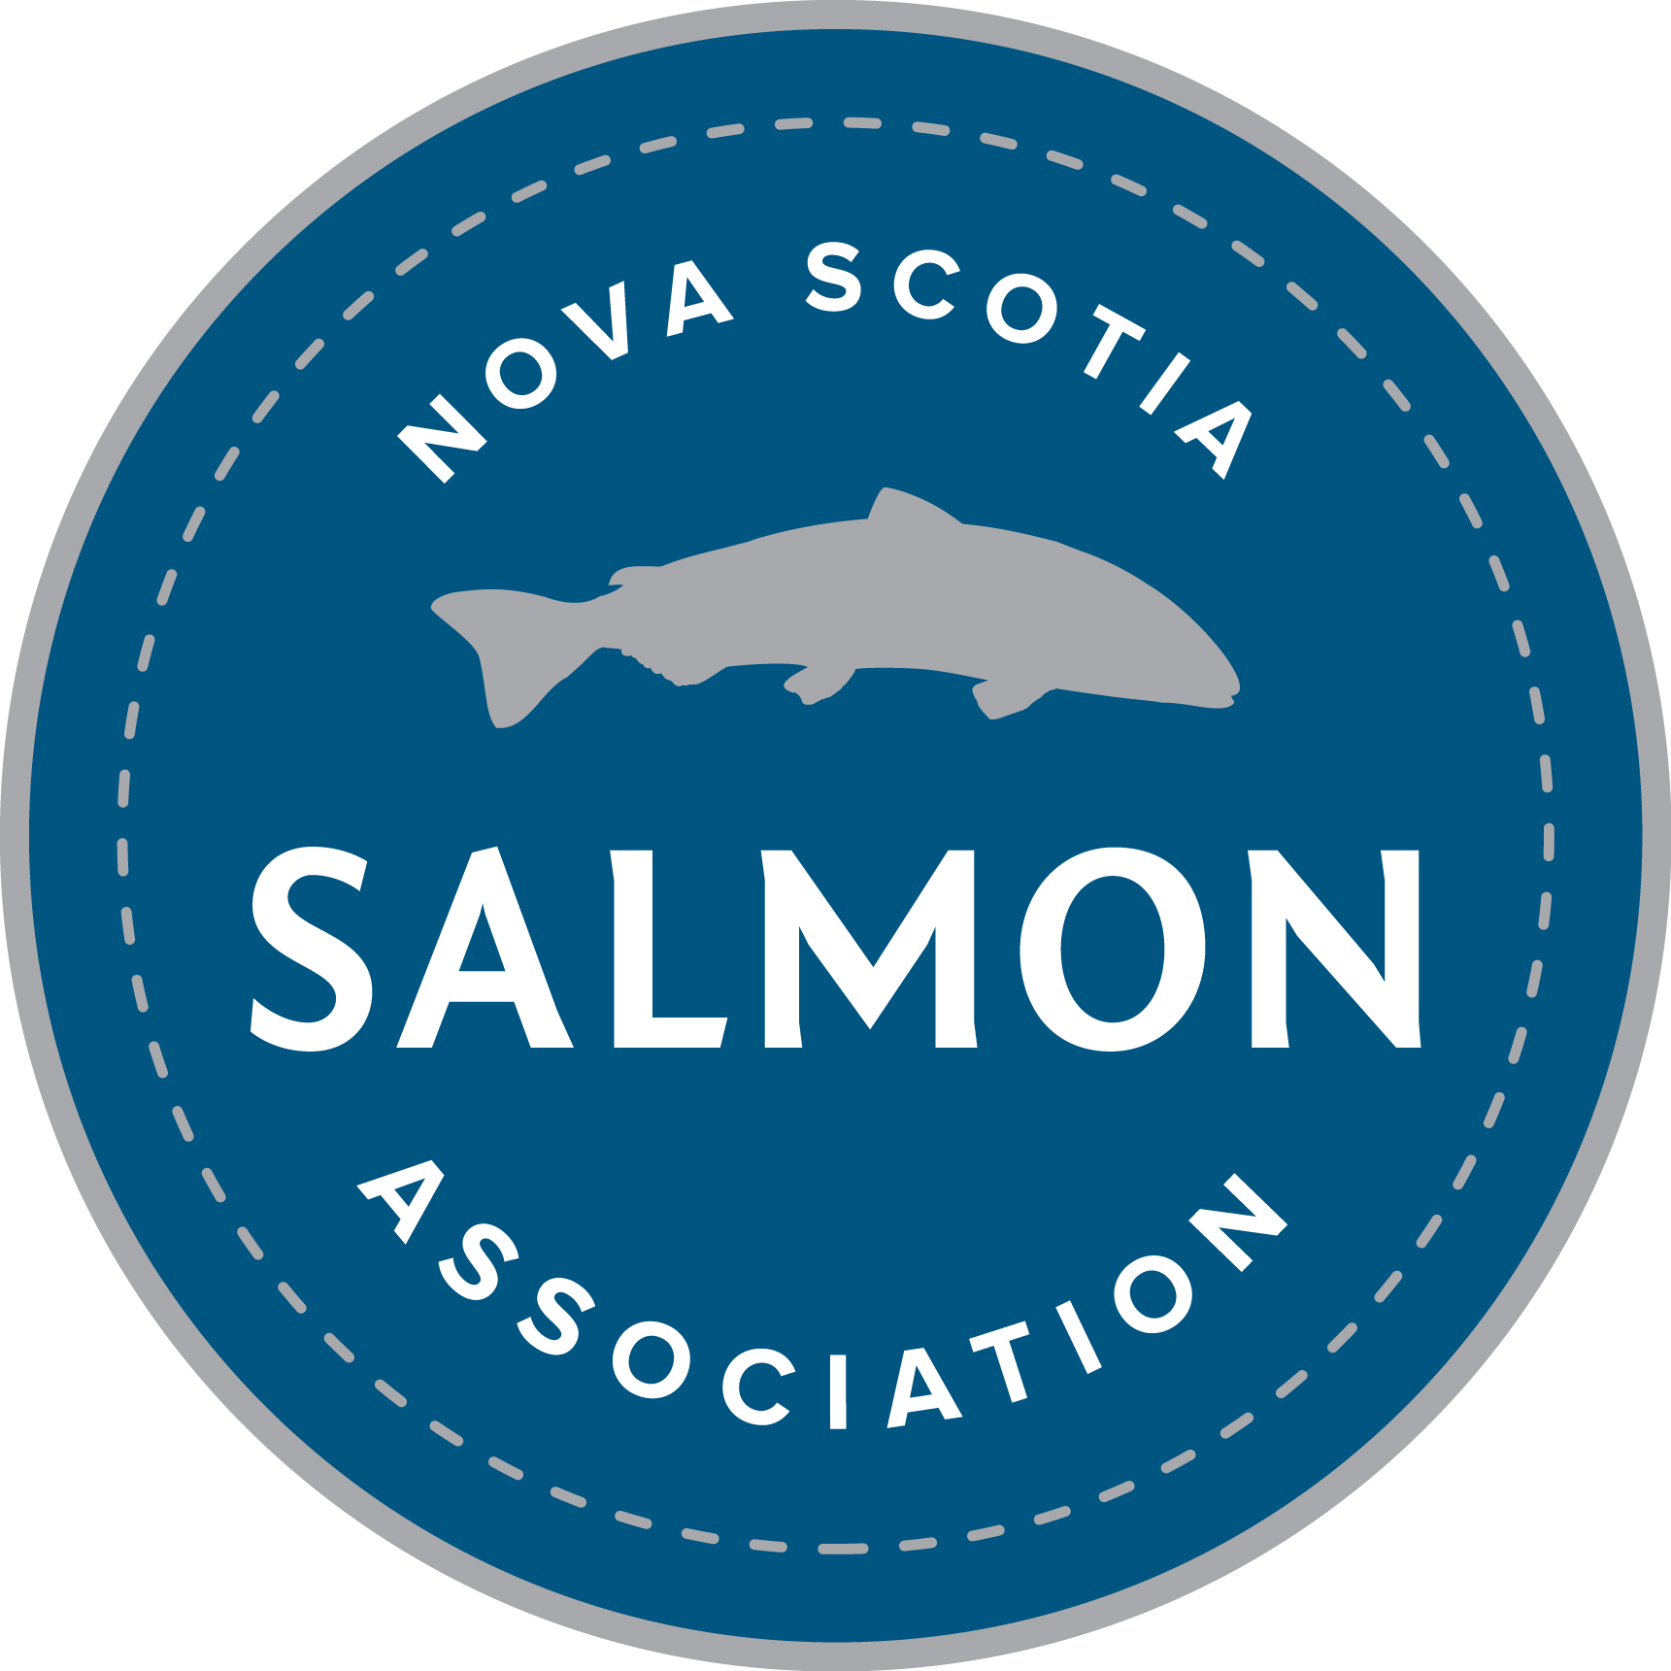
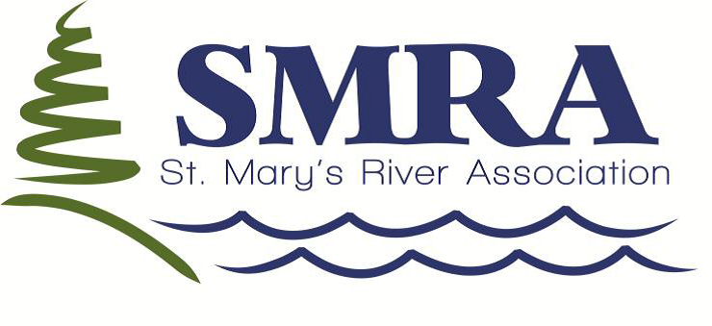
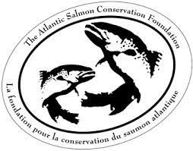
Project Partners
Nova Scotia Salmon Association and the Adopt a Stream Program
Canadian Nature Fund for Aquatic Species at Risk (DFO)
Atlantic Salmon Conservation Fund

Slide 4
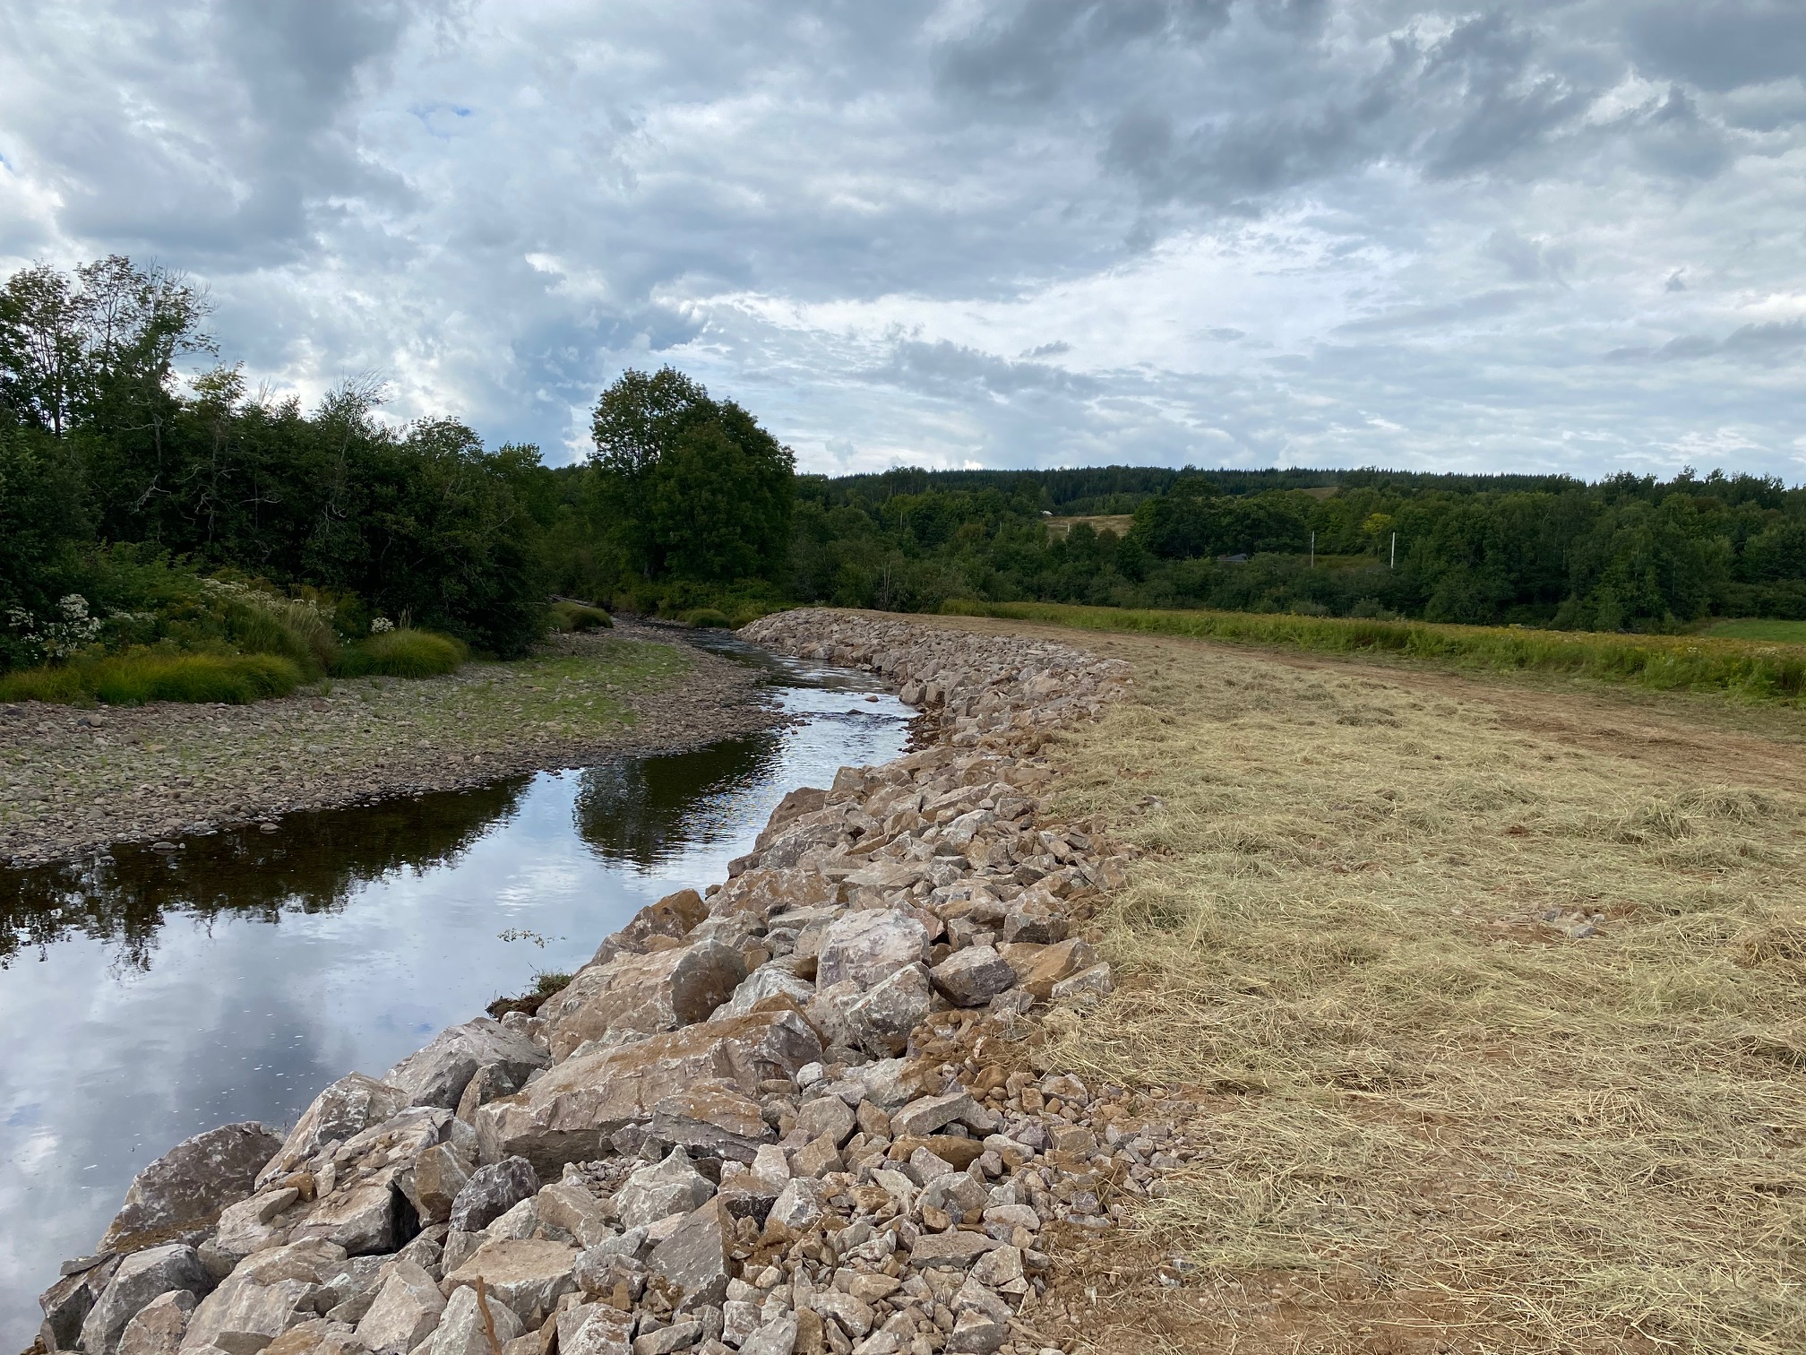
Black Brook
Bank stabilization work coupled with riparian zone planting.
Project resolved significant erosion site that was degrading downstream spawning habitat.
Channel widening was threatening upstream migration during summer months for Brook trout.
500 native trees planted to insure long-term function.

Slide 5
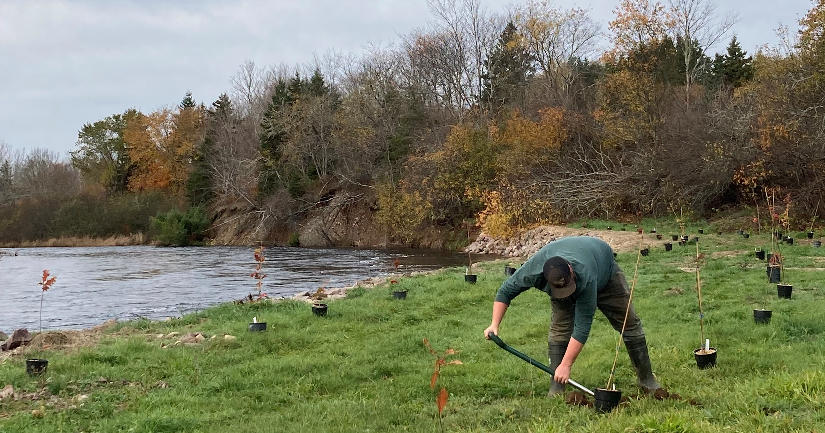
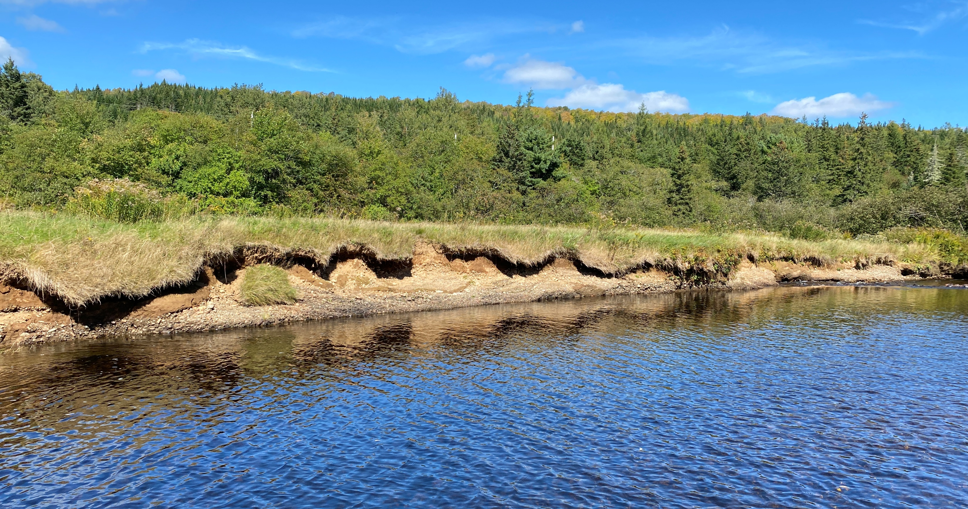
East River – Willowdale Site
Bank stabilization work with the incorporation of root wad structures.
Two sections of bank repair and 250 meters of riparian zone established.
500 native trees planted.

Slide 6
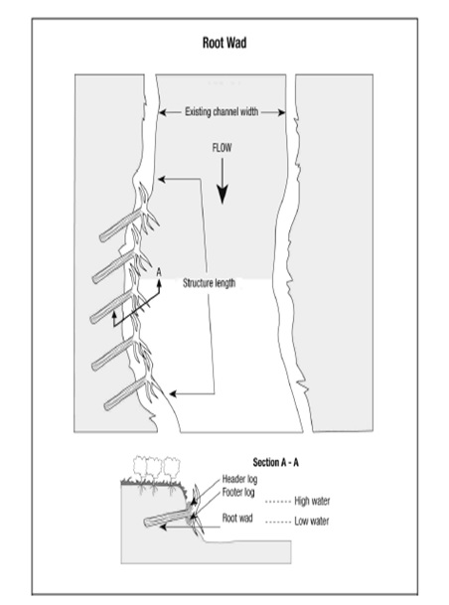
East River – Willowdale Site continued
Root wad structures – adding complexity and ecological function

Slide 7
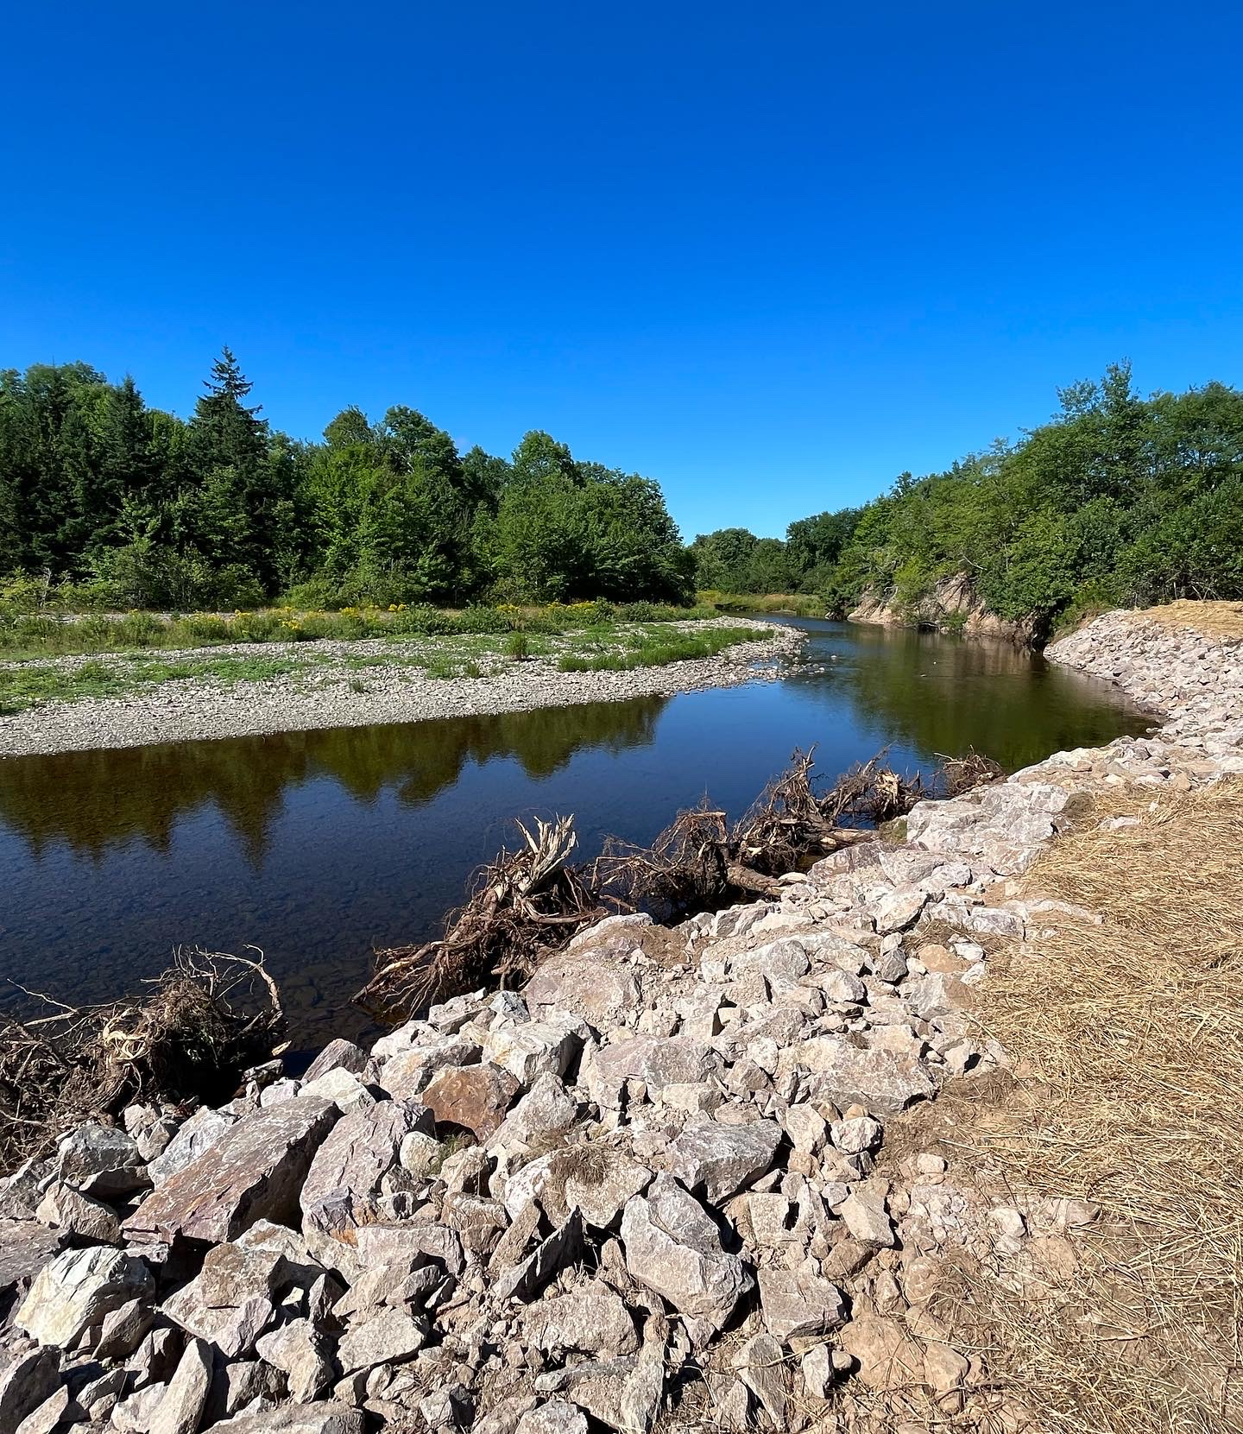
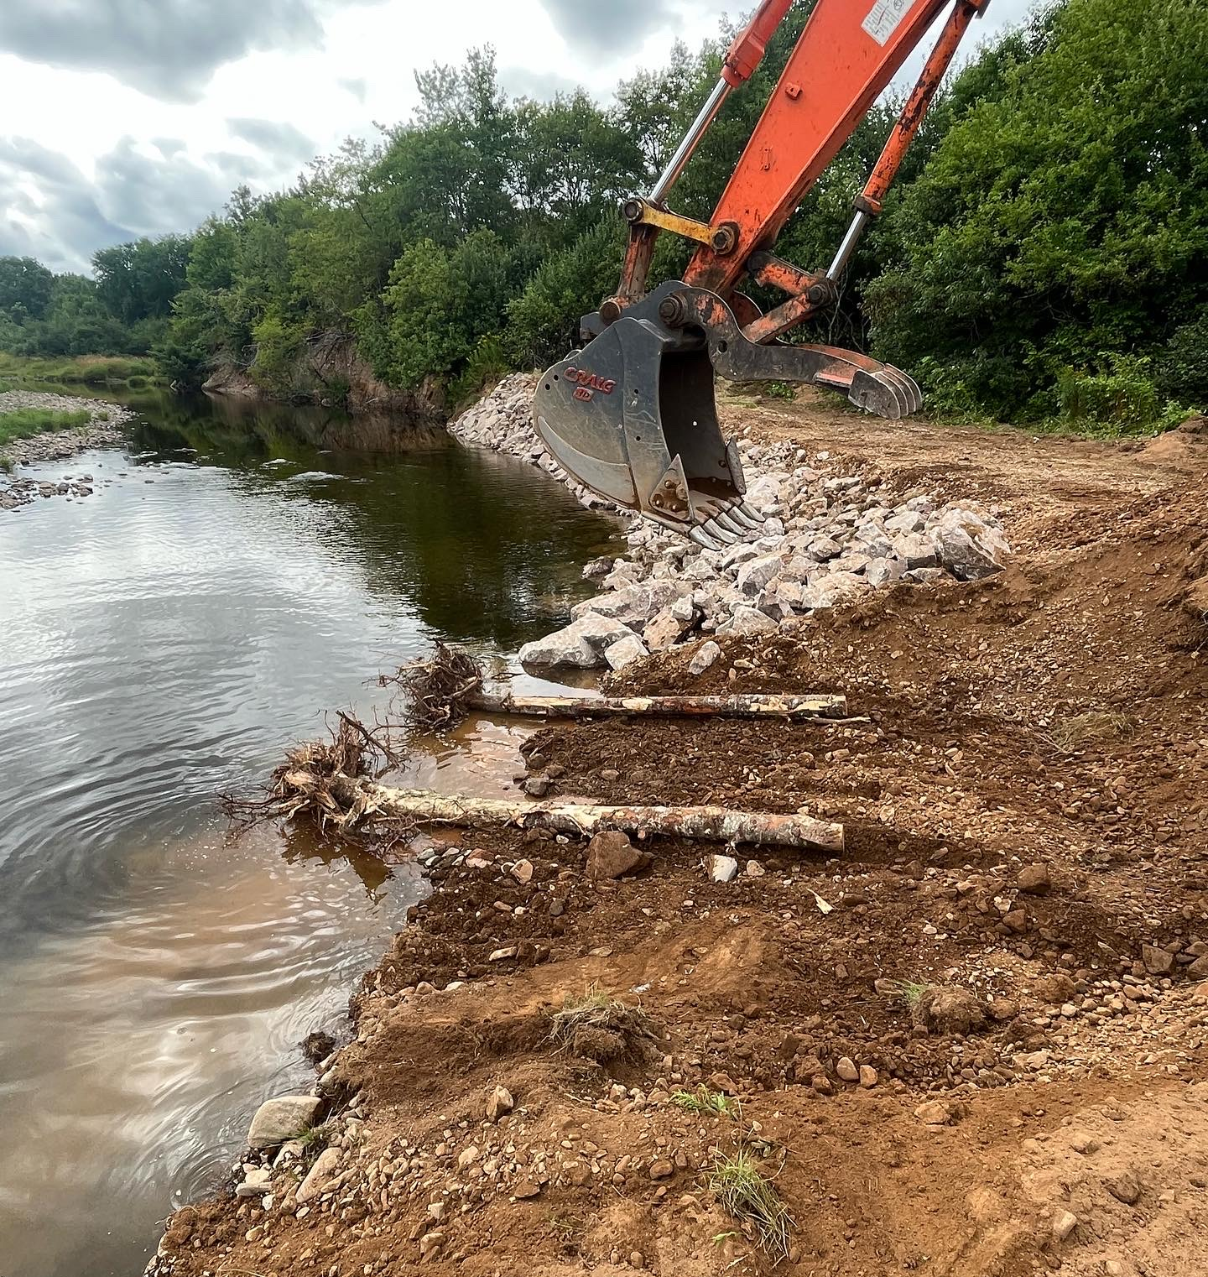
Willowdale Site continued

Slide 8
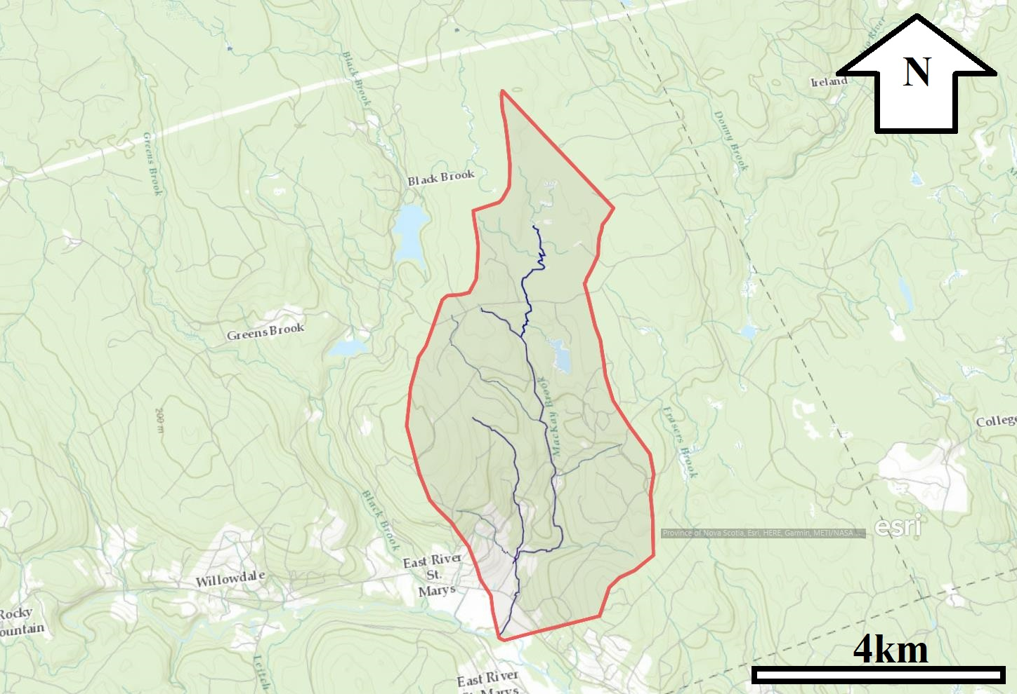
MacKay’s Brook
Project included the installation of 25 digger log structures.
Total restored area from project was 5000 square meters.

Slide 9
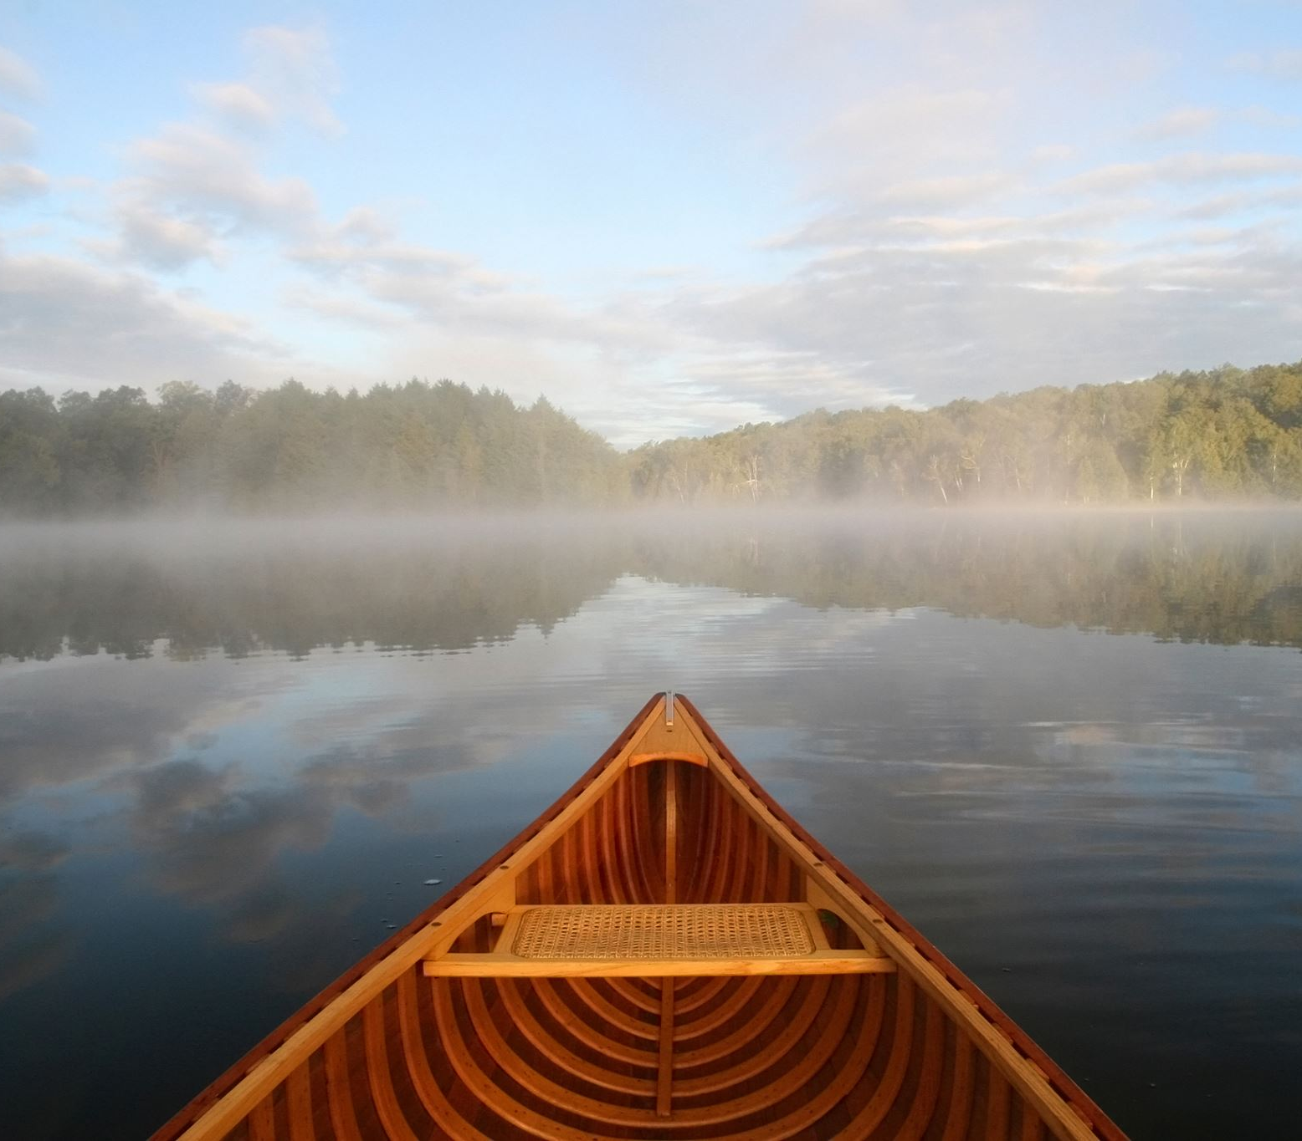
Moving ahead – What’s Planned for 2023
SMRA has successfully applied to DFO’s Aquatic Ecosystem Restoration Fund (AERF) to complete a four-year project.
AERF project will focus on completing high priority habitat restoration projects throughout the entire St. Mary’s River watershed.
Restoration work will include digger logs and deflector work using a crew as well as large-scale restoration work using machinery. Large-scale work will focus on developing cold-water refugia and important staging pools for Atlantic salmon.
A major component of this project will include a four-year monitoring program.
Fish passage barrier remediation project in year 1 (2023) also planned.

Slide 10
Funding is weighted heavily in 2024 & 2025

Slide 11
Allocation of funds 2023-2026
Year | Restoration | Monitoring | Total
2023-2024 | $80,000 | $70,000 | $150,000
2024-2025 | $450,000 | $100,000 | $550,000
2025-2026 | $565,000 | $100,000 | $665,000
2026-2027 | $140,000 | $60,000 | $200,000
Total | $1,235,000 | $310,000 | $1,545,000

Slide 12
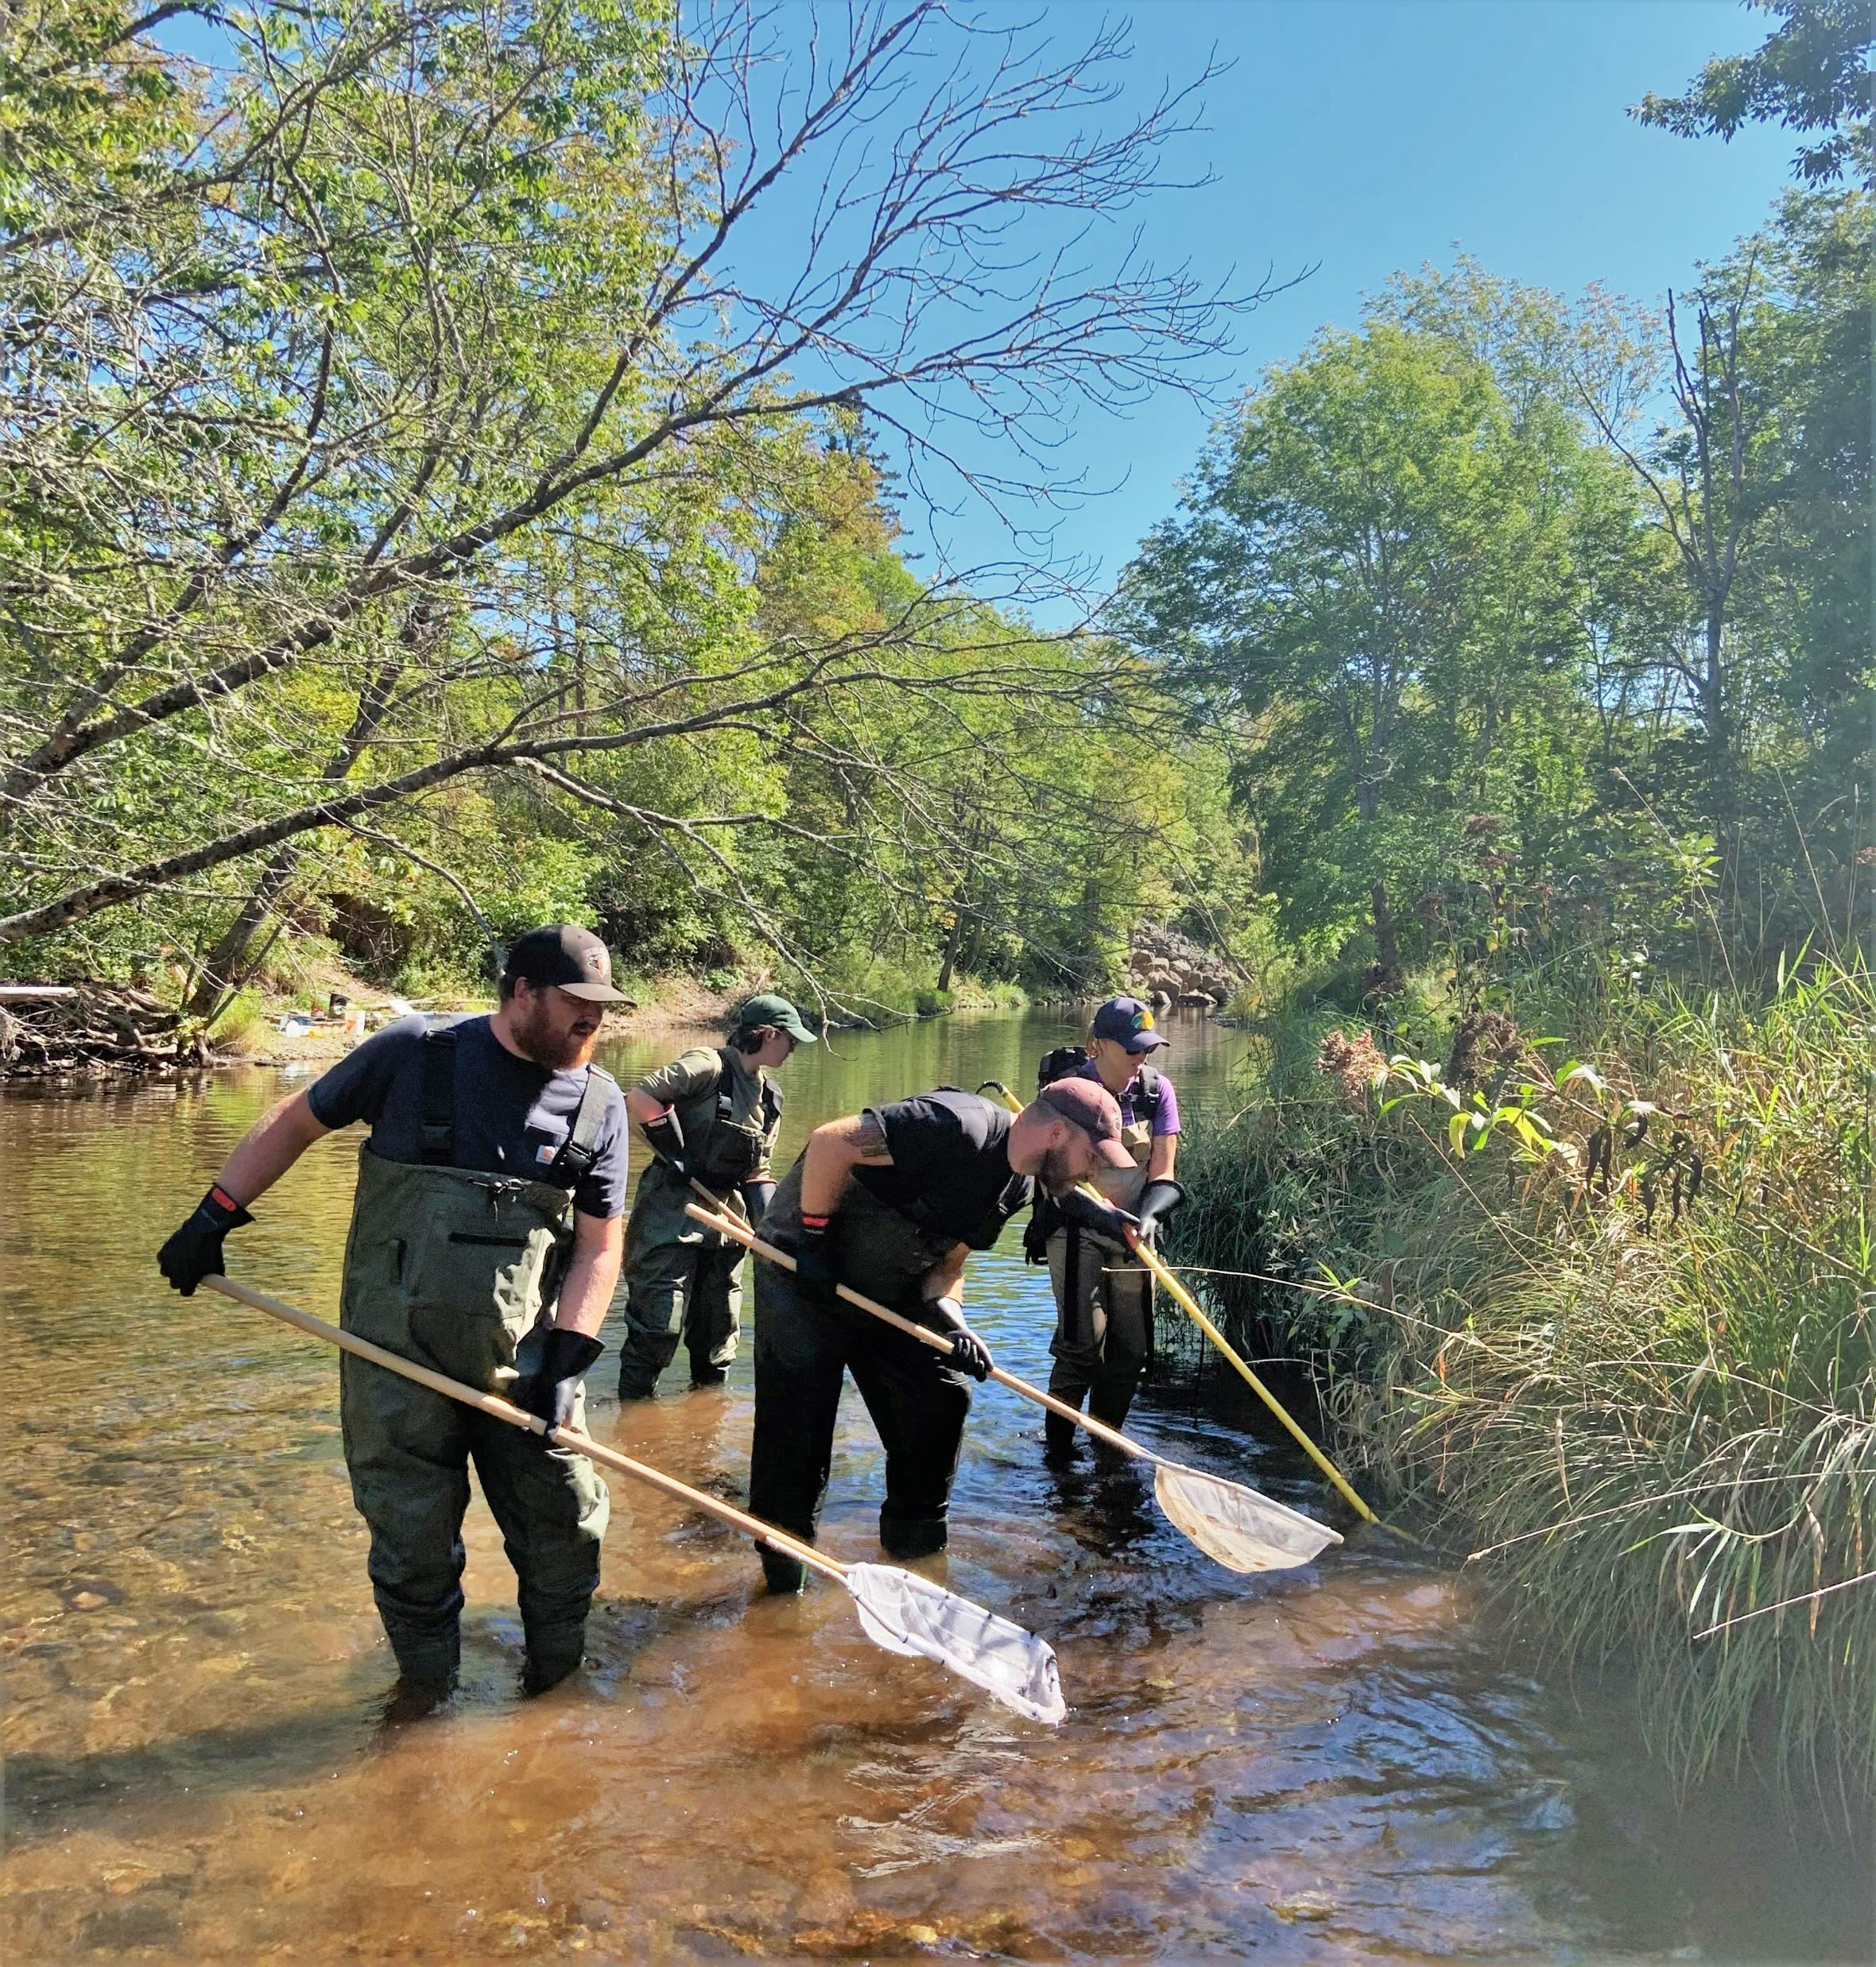
Monitoring Program
Intensive monitoring will be conducted on 6 tributaries to the St.Mary’s River
Garden River
Frasers Brook
Cross Brook
Barren Brook
McKeens Brook
Moose River

Slide 13
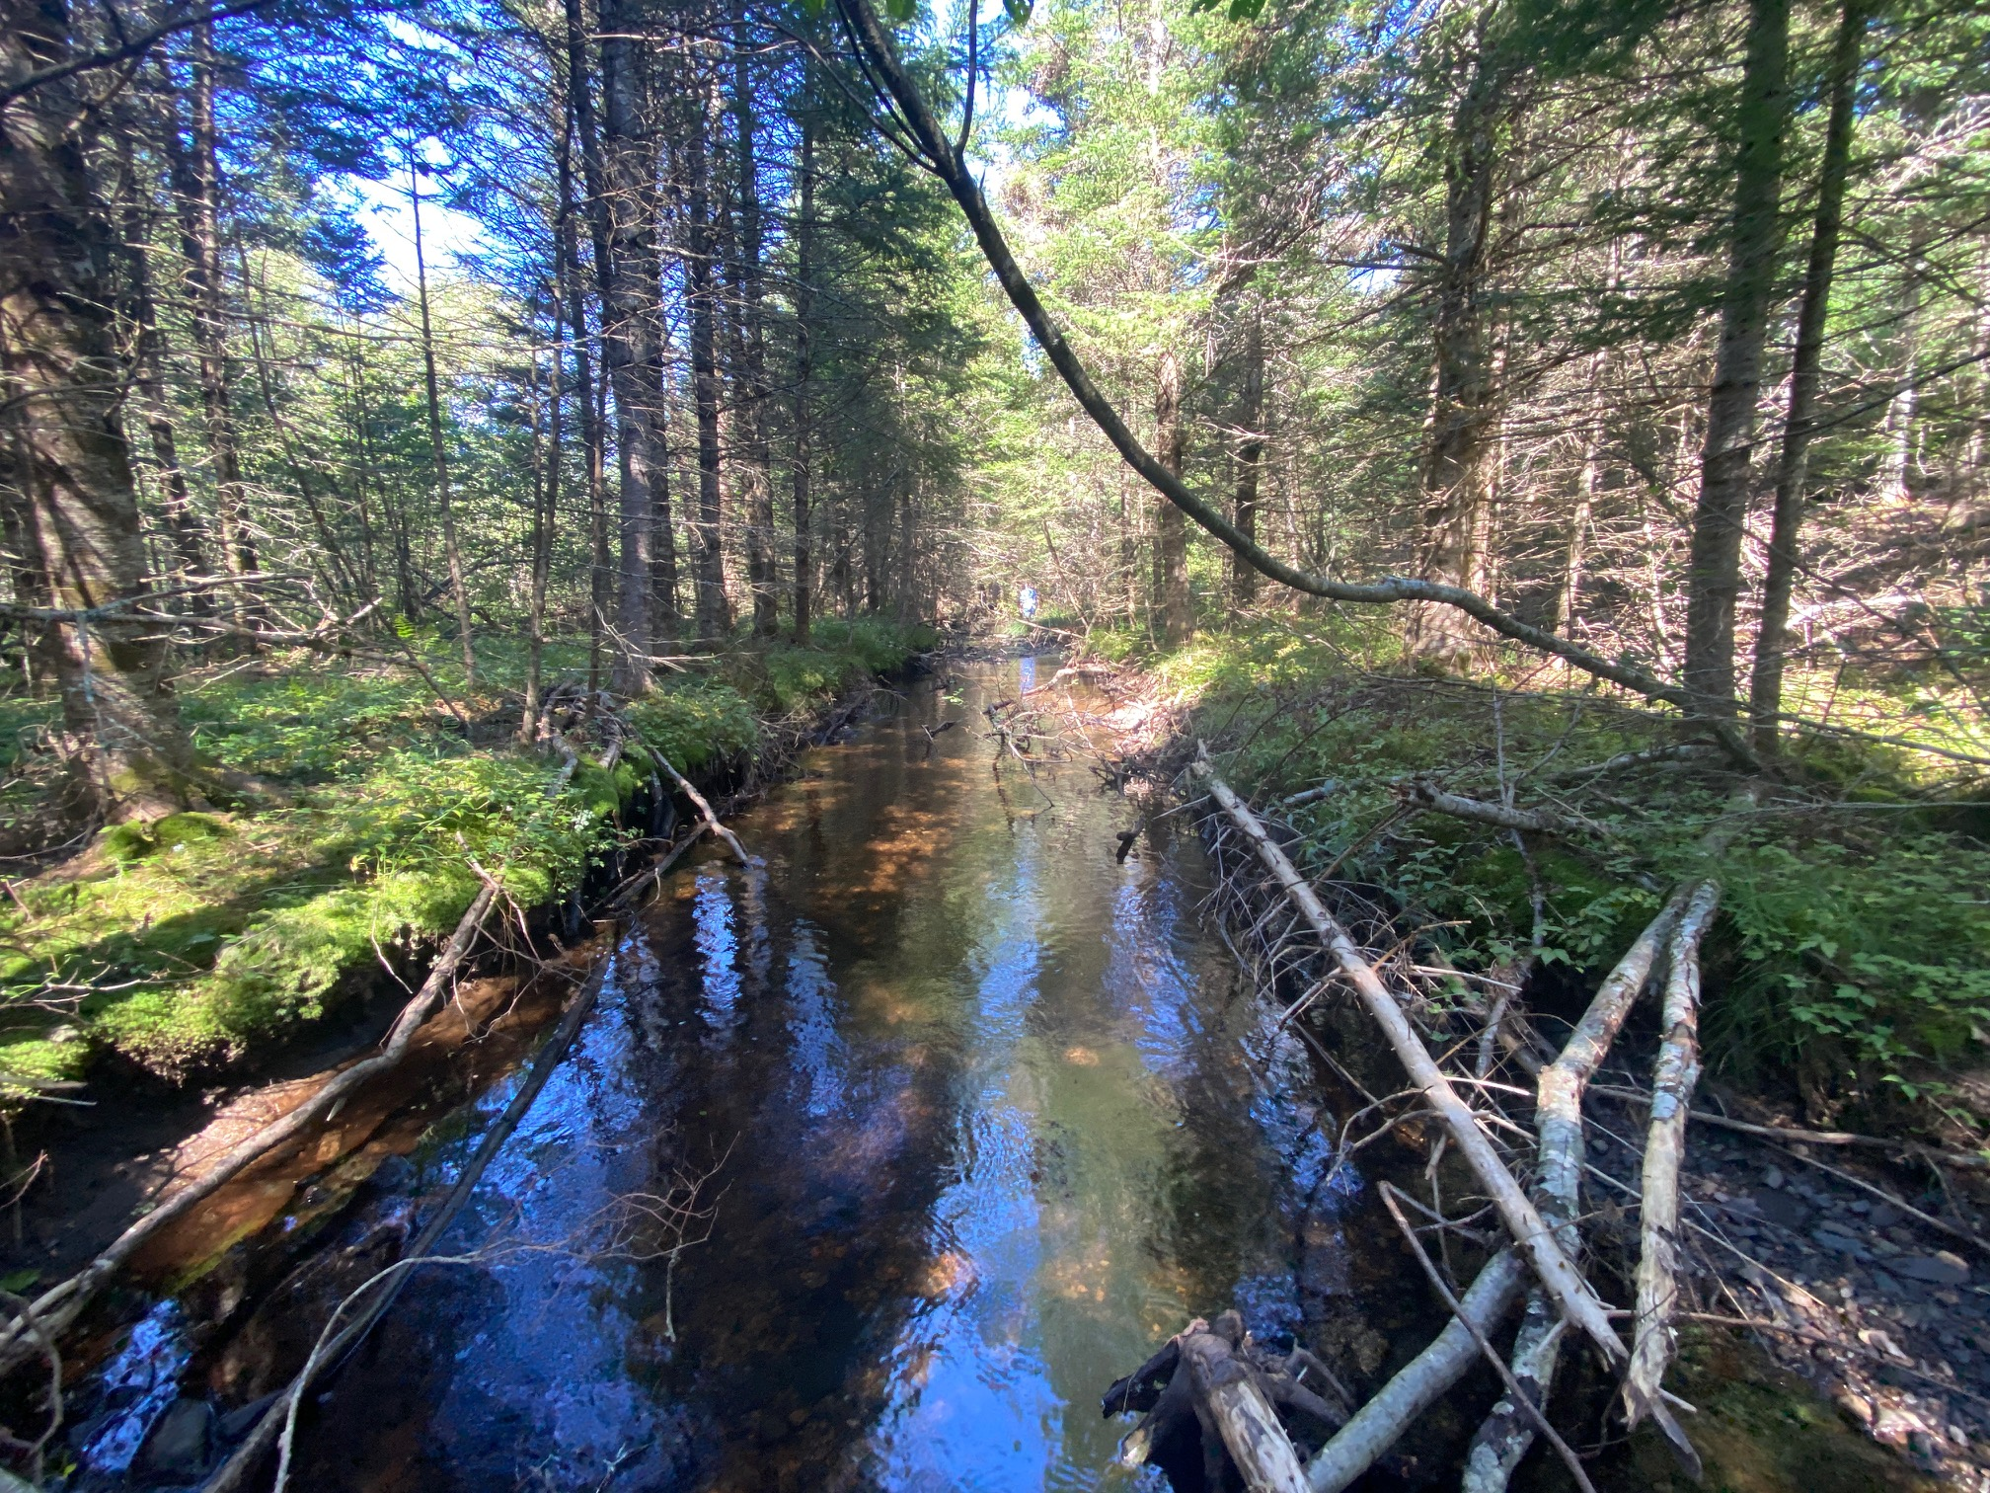
Monitoring Continued
Goals and Objectives for Monitoring Program:
Obtain better understanding of the Atlantic salmon populations in key tributaries using population assessment methods used by DFO – i.e. juvenile abundance estimates.
Juvenile abundance estimates will be extrapolated from electrofishing data.
Redd surveys will be used to estimate number of returning spawners.
Habitat Suitability Index surveys will be used to measure the effectiveness of habitat restoration work.
Water temperature monitoring will be completed throughout watershed to continue monitoring program that started in 2019.

Slide 14
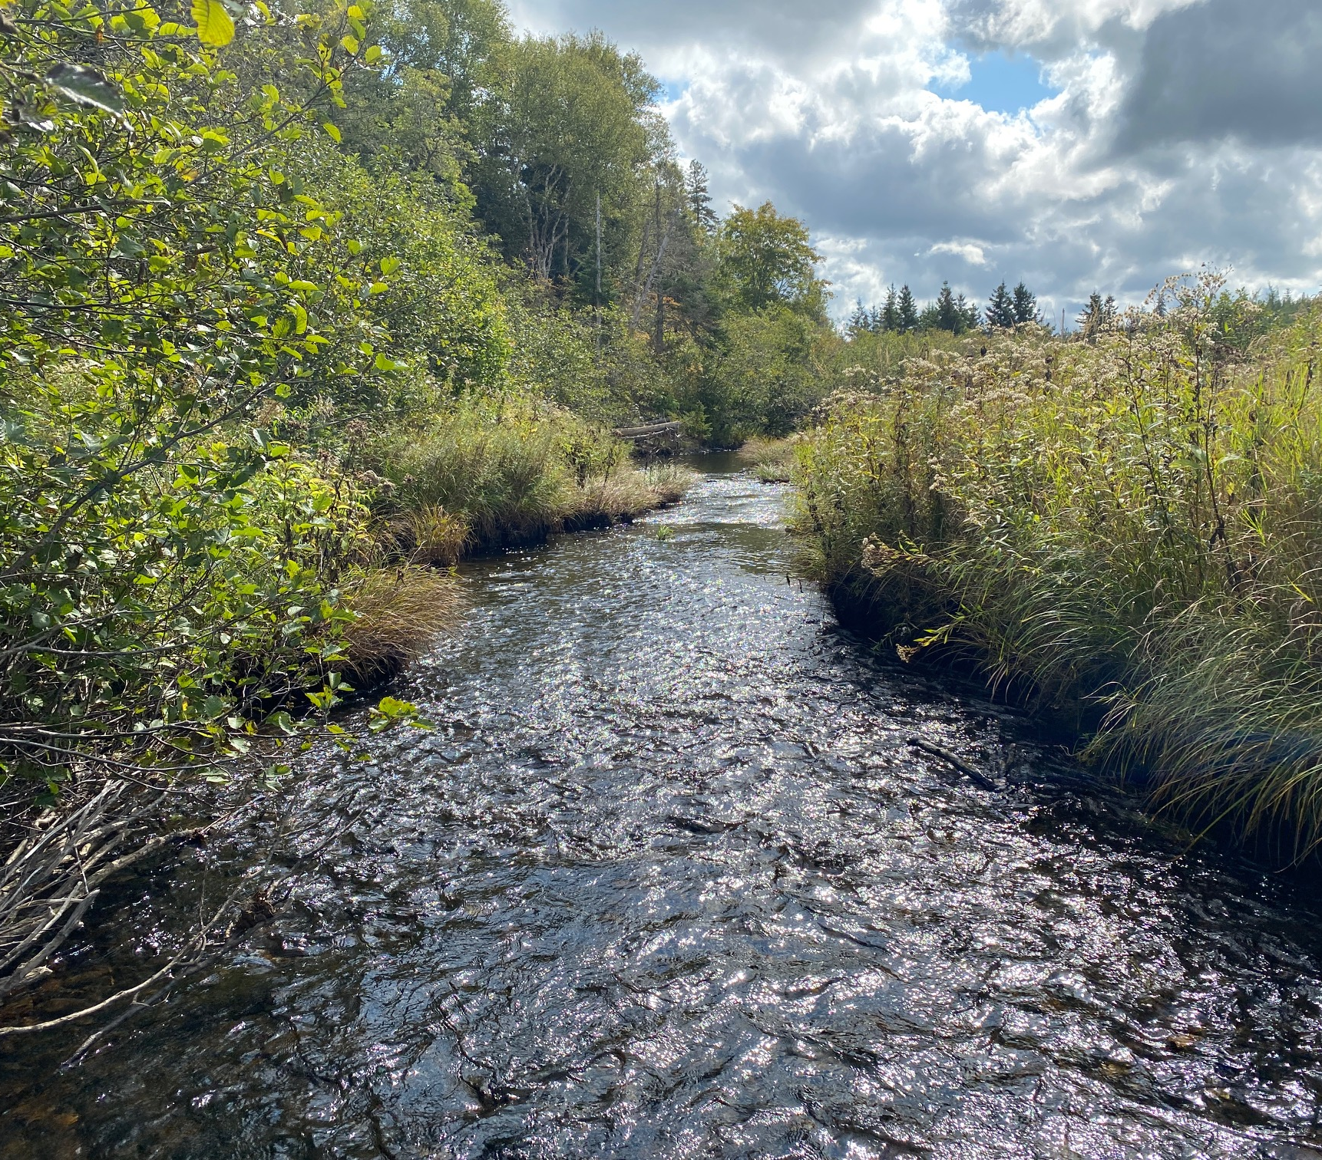
Human Resources
MNR will hire two field technicians to work on this project; Bruce Wheadon and Emma Purdy.
Field technicians will be responsible for collecting data, aiding in restoration project completion and report writing.
In 2024 and 2025 field technicians will be employed full-time from April 1 to March 31.
This will allow SMRA to provide DFO with labour to help operate smolt wheel as well as aiding SMRA volunteers during kelt-recapture study.

